Slide 1

Gender Recognition By Voice Analysis
Under The Supervision Of
Dr. Vishan Kumar Gupta
Associate Professor
Graphic Era University Dehradun
Project By:
Shashank Kothari
University Roll No. 2017020

Slide 2
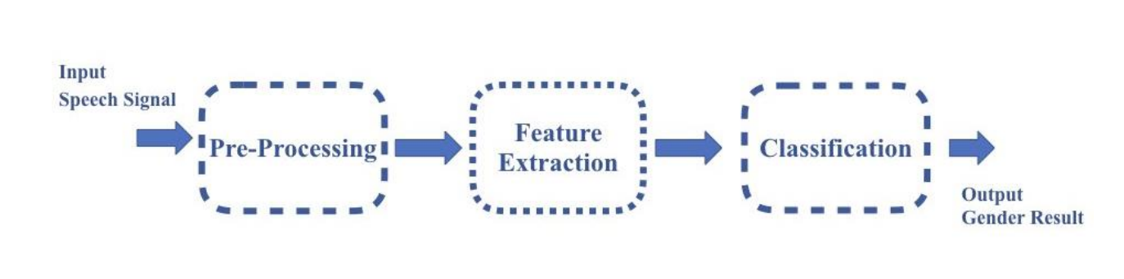
Introduction
Gender Recognition By voice is a technique which is often utilized to determine the gender of speaker by his/her speech signals. Speech signals taken from a recorded speech can be used to acquire acoustic attributes such as IQR , frequency etc.

Slide 3

Problem statement
classifying a person’s gender based upon his/her acoustic properties of voice.
Machine learning techniques can be used on these type of problem statements.
The learning used here should be supervised learning as we know the actual output and we can compare the predictions with it.

Slide 4

Techniques / technologies used
Data science libraries such as pandas ,matplotlib, seaborn, numpy , etc.
Machine learning library , sklearn used with many subordinate models such as model_selection , classifiers , metrics etc.
Jupyter notebook used for implementation.
Dataset used available on kaggel.it consist of 3168 recorded voice sample from male and female speakers.
The analysed frequency range was of 0 hz -280 hz(human voice range).
The above acoustic analysis was done by the source itself.

Slide 5
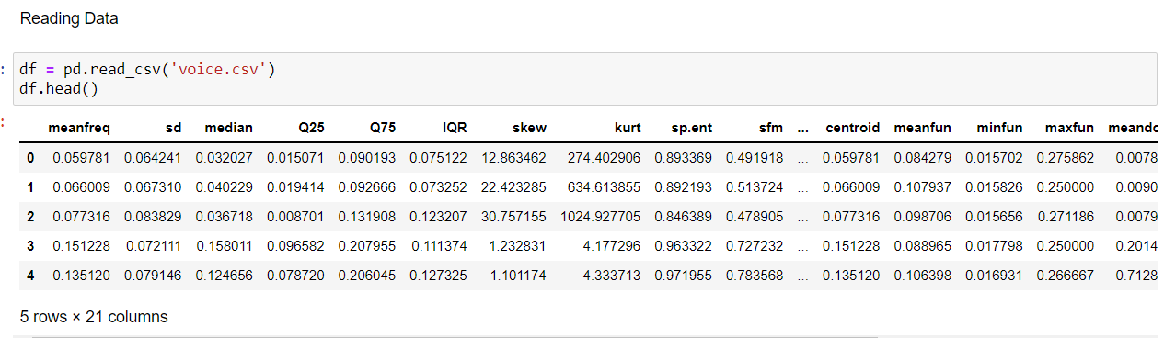
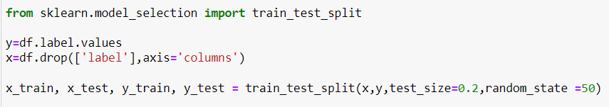
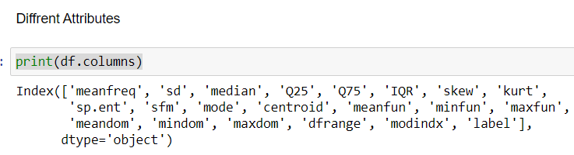
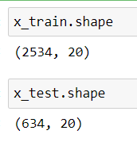
Methodology
Reading data
Giving labels
0 for male
1 for female
Splitting dataset Into Training and Testing Set
80% Training set
20% Test set

Slide 6
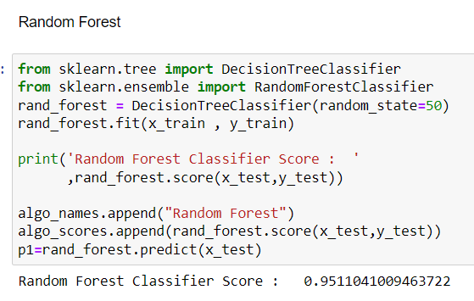
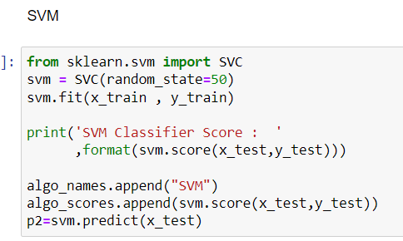
Applying the classification models:
Random Forest Model
Random Forest is a classifier that contains a number of decision trees on various subsets of the given dataset and takes the average to improve the predictive accuracy of that dataset." Instead of relying on one decision tree, the random forest takes the prediction from each tree and based on the majority votes of predictions, and it predicts the final output.
Support Vector Machine Model
The goal of the SVM algorithm is to create the best line or decision boundary that can segregate n-dimensional space into classes so that we can easily put the new data point in the correct category in the future. This best decision boundary is called a hyperplane. SVM chooses the extreme points/vectors that help in creating the hyperplane. These extreme cases are called as support vectors, and hence algorithm is termed as Support Vector Machine.

Slide 7
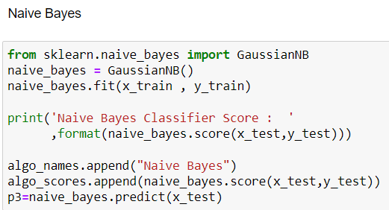
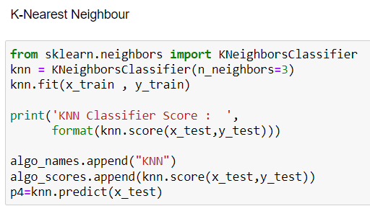
Naïve Bayes
Naïve Bayes algorithm is a supervised learning algorithm, which is based on Bayes theorem and used for solving classification problems.
It is mainly used in text classification that includes a high-dimensional training dataset. It is a probabilistic classifier, which means it predicts on the basis of the probability of an object.
K-Nearest Neighbour
K-NN algorithm assumes the similarity between the new case/data and available cases and put the new case into the category that is most similar to the available categories.
K-NN algorithm stores all the available data and classifies a new data point based on the similarity. This means when new data appears then it can be easily classified into a well suite category by using K- NN algorithm

Slide 8
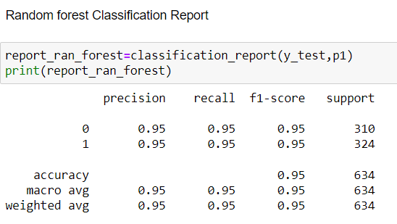
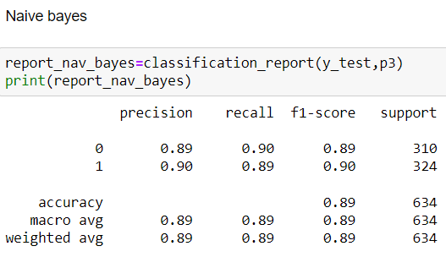
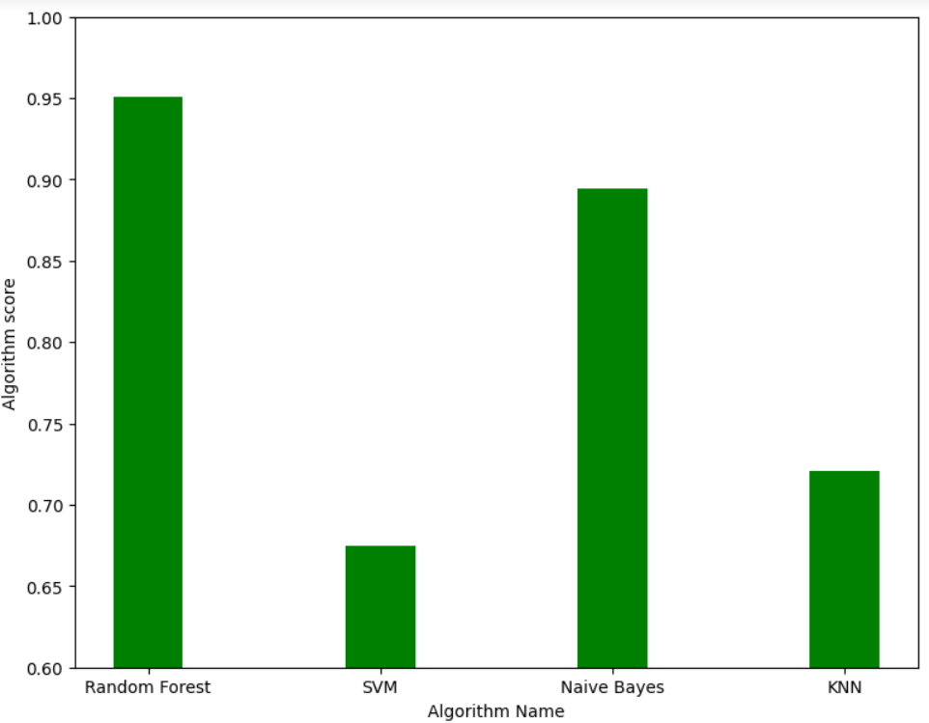
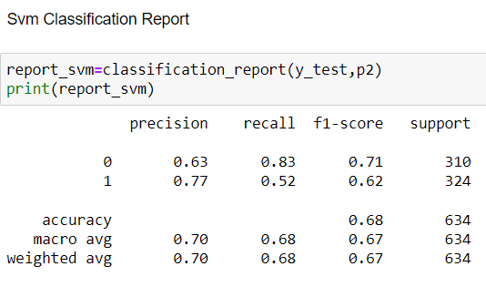
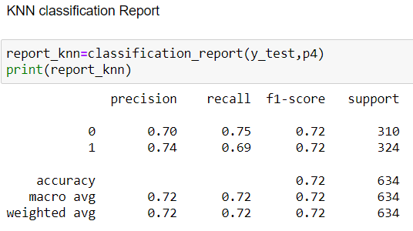
Result and discussion:
classification models report:
classification score bar graph

Slide 9
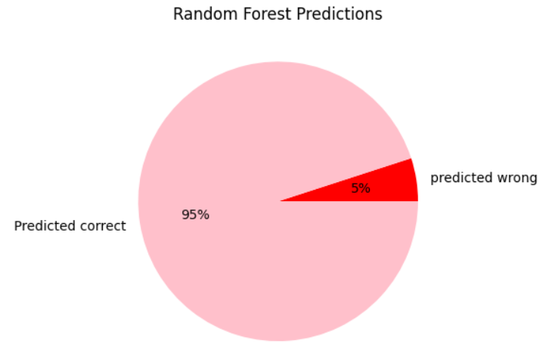
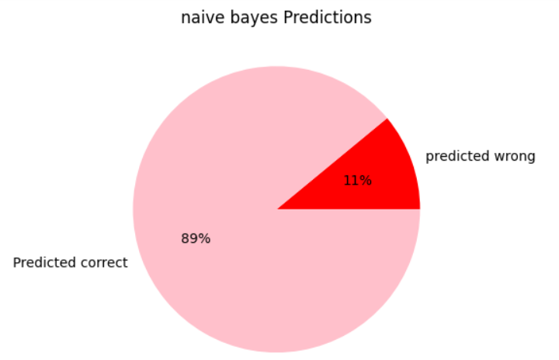
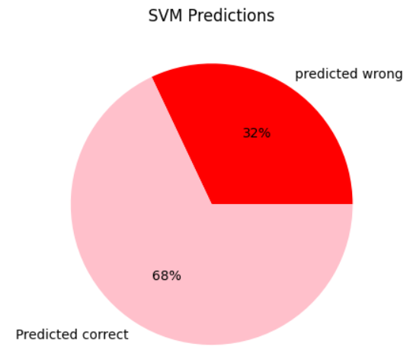
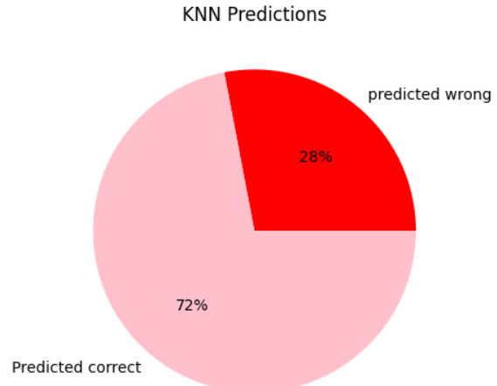
Result and discussion:
Pie chart

Slide 10
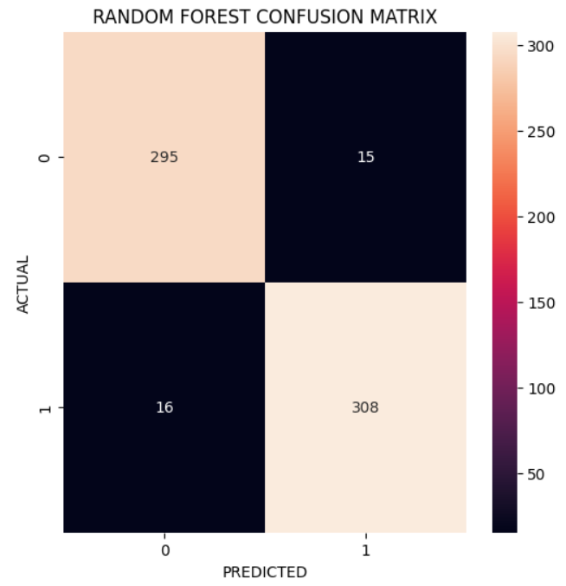
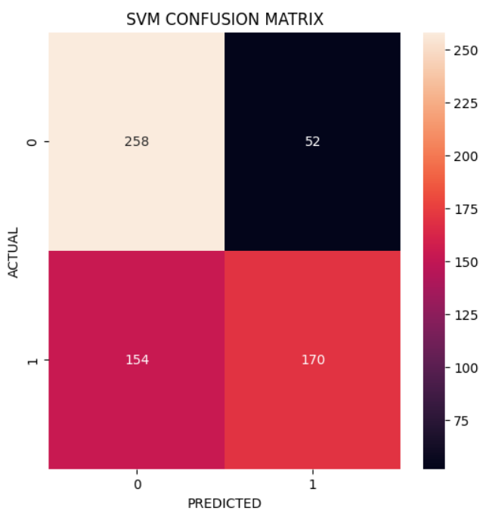
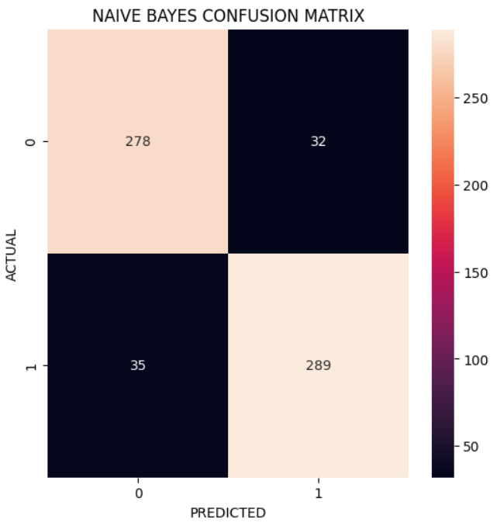
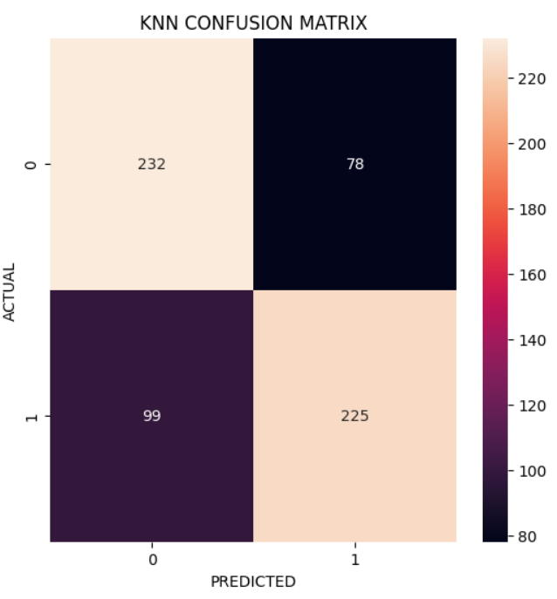
Result and discussion:
Confusion matrix

Slide 11


conclusion:
BASED ON PRECISION, F-SCORE , RECALL VALUES, PIE CHART ,ACCURACY SCORE AND CONFUSION MATRIX WE CAN SAY THAT AMONG ALL THE ABOVE ALGORITHMS RANDOM FOREST CLASSIFICATION IS BEST SUITED FOR THIS PROBLEM.
SUPPORT VECTOR MACHINE IS LEAST SUITABLE BASED ON SAME ANALYSIS.

